Slide 1





Go-to Market Strategy 2026

Slide 2
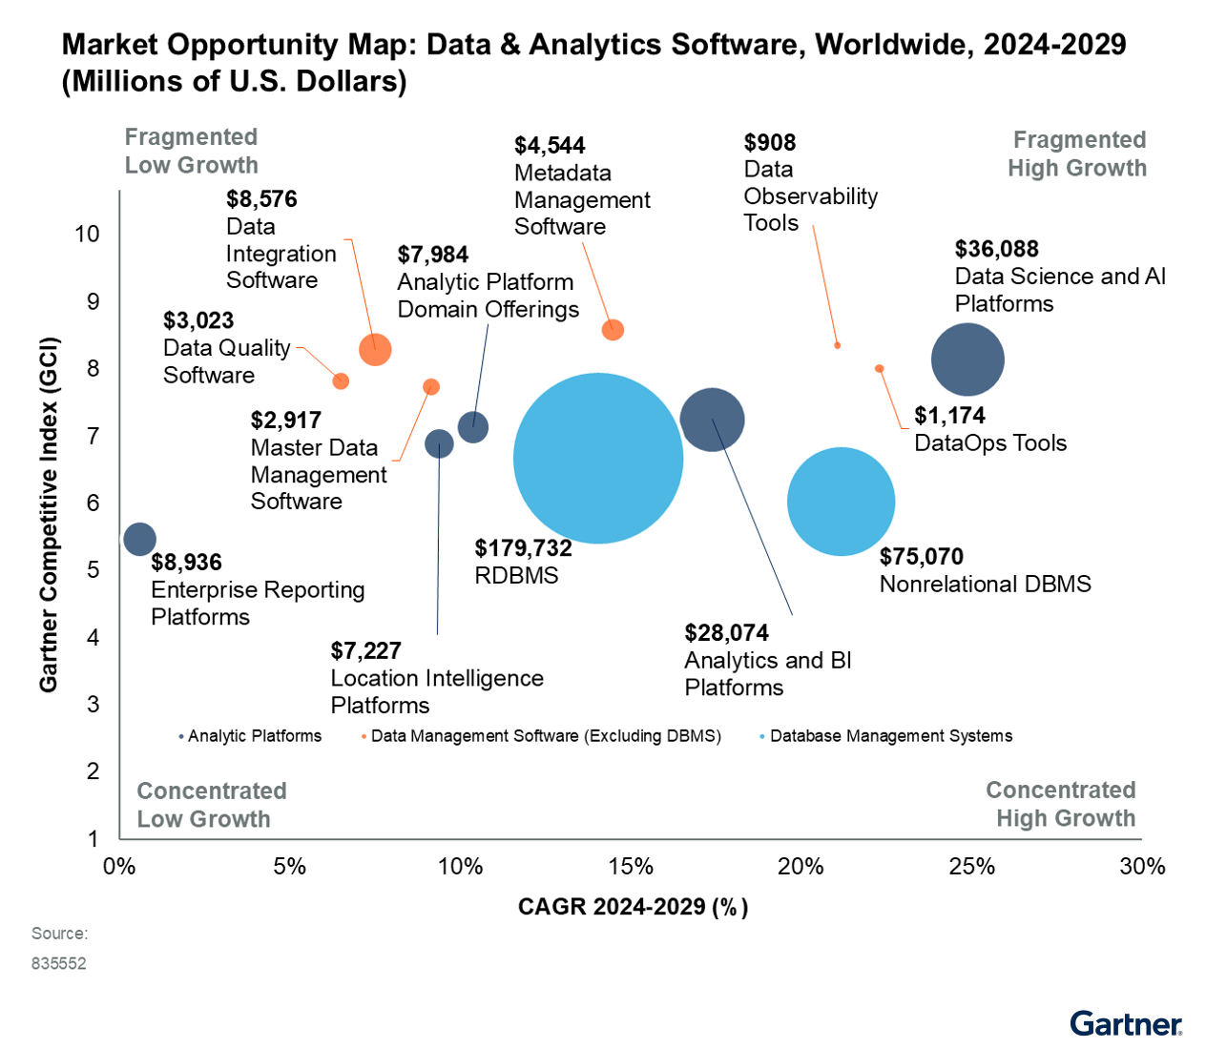

Slide 3
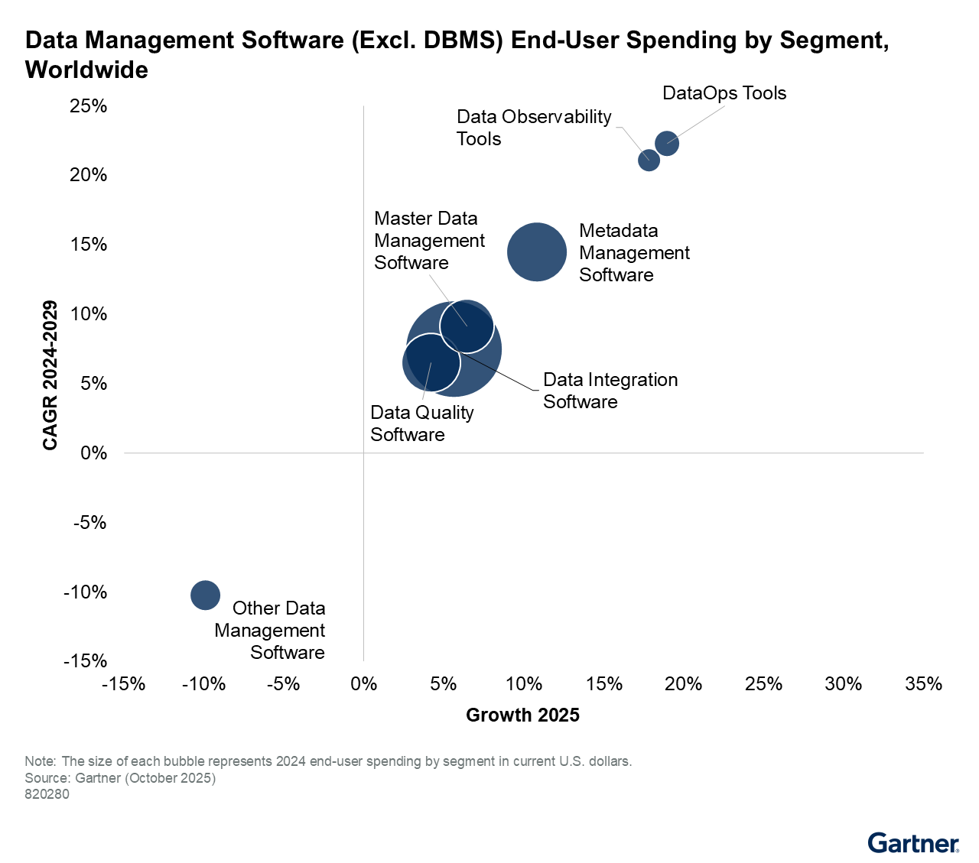

Slide 4
Top Focus Area
Master and Meta-data Management
Data Quality
Data Integration
Collectively they form approximately USD 19 bn market, growing @ 10-12% annually

Slide 5
Supply Chain Management & Asset Lifecycle Management LOB
Line of Business (LOB) | Domain | Data Elements
Supply Chain Management | Material | MRO, Raw materials, Capital goods, Finished goods, Semi-finished goods, Tools
 | OEMs/Vendors | Vendor master, Supplier details
 | Services | Service master, Bill of services (BoM), Model Service specifications (MSS), Service contracts, Hierarchy management, Classification management
 | Meta Data | Material types, Material Groups, Purchasing Groups, UOM (Units of Measure), Asset categories, Currencies, Taxonomies, FMEA Library, Maintenance Strategies
 | Article | Retail and fashion Management
Asset Lifecycle Management | Asset (PM/EAM) | Plant, Functional location, Equipment Master, BOM, Maintenance plan, Maintenance items, Task lists, Task list operations, Failure codes, Measuring points and counters
 | BOM | Functional location BOM, Equipment BOM, Manufacturing BOM, Production BOM

Slide 6
Marketing Roadmap Strategy for 2026
Reflecting on the years 2024 and 2025, please let us know what worked for you that lead to success?
Reflecting on the years 2024 and 2025, please let us know what did not work for you?
Which three go-to-market challenges should we prioritize in 2026 to improve pipeline quality, conversion, and customer adoption?

Slide 7
Reflecting on the years 2024 and 2025, please let us know what worked for you that lead to success?
SAP Endorsed App added value, Premium certification integration
SAP AEs – reaching direct connects
Asset master data objects involvement, ICF, workshops, conferences with SAP team
Customer references
AI driven features (Copilot, AI Agent)

Slide 8
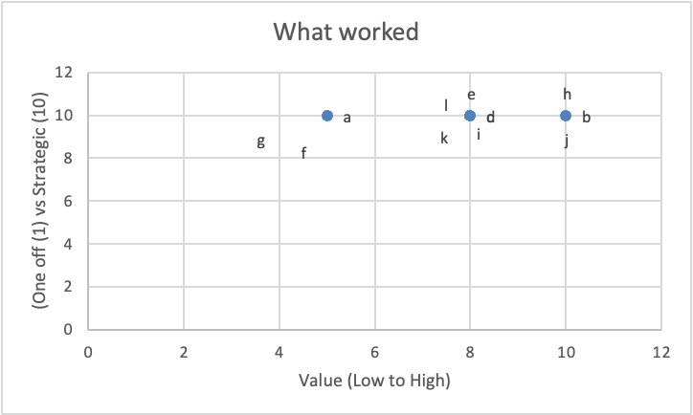
What worked
Ref# | What worked
a | SAP's respect
b | DQG endorsement
c | Direct connects within account and via SAP AEs
d | Credibility and visibility of SAP events
e | Certified integrations
f | Past successful project completions
g | Customer references
h | AI driven features
i | Focus on standard driven content (ISO)
j | AI driven MDM feature
k | Repository (iCF)
l | Partnership with SAP

Slide 9
Reflecting on the years 2024 and 2025, please let us know what did not work for you?
Longer sales cycle
Customer success stories
Relationships within partner network, budget approvals, competition
POV/POC to build the confidence
Building a trusted relationship with SAP AEs, as they are also not aware of PiLog, dedicated team from SAP will support us case by case (email has been triggered to entire AEs last week)
Market visibility in certain regions and branding
Licensing model, benefits to be articulated properly, ROI calculation, etc.
Battle cards based on Region, Industry, etc.
Future Innovations -- Joule integration, BTP

Slide 10
What didn’t work
Ref# | What didn't work?
A | Longer sales cycle
B | Issues with messaging & communication
C1 | Relationship within partner network. Budget approvals. Beat competition
C2 | Relationship within partner network. Budget approvals. Beat competition
D | More effort on delivery (POV)
E | Global SAP team doesn't understand PiLog's niche
F | Necessary support from SAP. SAP AEs view PiLog as nuisance.
G | Poor lead to Opportunity conversion
H | Building a trusted relationship with SAP AE and Market Dynamics
I | Volume of licenses/ tier structure
J | Low Brand name recognition in new markets
K | Market visibility
L | Branding
M | Diversification of investments in Saudi.
N | Budget of customers constrained
O | Lot of competition
P | Increase visibility to Clients
Q | Do more webinars in local language
R | Promotion of content by project managers.. account managers etc.
S1 | Creation of Good use cases; and fine tune use cases
S2 | Creation of Good use cases; and fine tune use cases
T | Not much traction from SAP BTP
U | Licensing model benefits
V | Battle cards - Adv and Disadv of competitor solutions
W | Battle cards based on region, industry
X | ROI calculation
Y | Webinars for each IBU
Z | Future innovations - BDC use cases. joule integration
AA | Build the campaigns on pain points

Slide 11
What didn’t work
Ref# | What didn't work?
A | Longer sales cycle
B | Issues with messaging & communication
C1 | Relationship within partner network. Budget approvals. Beat competition
C2 | Relationship within partner network. Budget approvals. Beat competition
D | More effort on delivery (POV)
E | Global SAP team doesn't understand PiLog's niche
F | Necessary support from SAP. SAP AEs view PiLog as nuisance.
G | Poor lead to Opportunity conversion
H | Building a trusted relationship with SAP AE and Market Dynamics
I | Volume of licenses/ tier structure
J | Low Brand name recognition in new markets
K | Market visibility
L | Branding
M | Diversification of investments in Saudi.
N | Budget of customers constrained
O | Lot of competition
P | Increase visibility to Clients
Q | Do more webinars in local language
R | Promotion of content by project managers.. account managers etc.
S1 | Creation of Good use cases; and fine tune use cases
S2 | Creation of Good use cases; and fine tune use cases
T | Not much traction from SAP BTP
U | Licensing model benefits
V | Battle cards - Adv and Disadv of competitor solutions
W | Battle cards based on region, industry
X | ROI calculation
Y | Webinars for each IBU
Z | Future innovations - BDC use cases. joule integration
AA | Build the campaigns on pain points

Slide 12
What didn’t work
Theme | Ref#(s) | What didn’t work (summarised) | Strategic (avg) | Criticality (avg) | Time to Address (avg) | Value $ (avg)
Sales Cycle, Conversion & Commercial Friction | A, C1, G, I, N, U, X | Long sales cycles, poor lead-to-opportunity conversion, constrained budgets, licensing & ROI challenges | ~7.4 | ~5.4 | ~6.7 | ~7.9
Messaging, Content & Go-to-Market Effectiveness | B, Q, R, S2, Y, AA | Weak messaging, limited local-language content, insufficient webinars, lack of pain-point driven campaigns | 10 | ~8.3 | ~6.0 | ~7.2
SAP Ecosystem & Partner Relationship Challenges | C2, E, F, H, T | Limited SAP alignment, AE resistance, partner relationship gaps, low traction with SAP BTP | 10 | ~7.8 | ~3.4 | ~8.2
Product Value Articulation & Use-Case Clarity | D, S1 | POV-heavy delivery, insufficiently articulated or refined use cases | 10 | 8.0 | 4.0 | 8.0
Brand Visibility, Market Awareness & Positioning | J, K, L, P | Low brand recognition and market visibility, especially in new markets | 10 | 7.0 | 2.0 | 6.0
Competitive Intensity & Sales Enablement Gaps | O | High competition without strong enablement differentiation | 1 | 2 | 5 | 9
Innovation, Platform Strategy & Future Readiness | Z | Need for future innovations (BDC use cases, Joule integration) | 10 | 7 | 8 | 8
Uncontrollable / External Factors | M | Macro investment diversification (e.g. Saudi) | 1 | 2 | 3 | 5
Sales Enablement Suggestions (Not Issues) | V, W | Battle cards by competitor / region / industry (solutions, not failures) | 10 | 8 | 2 | 8

Slide 13
One go-to-market challenges should we prioritize in 2026 to improve pipeline quality, conversion, and customer adoption?
Region wise workshops with all stakeholders, SAP AEs
Demo showroom with all videos, features. Learning Hub
Building & Publishing more Customer Success Stories on regular basis
Pain points of the customer, customer journey maps
Partner engagement, ecosystem, messaging, GTM decks, webinars

Slide 14
Suggestion
Ref# | Suggestions
S1 | A standard package/bundle that shows how our portfolio hooks into a SAP Rise project
S1 | A standard package/bundle that shows how our portfolio hooks into a SAP Rise project
S2 | Region wise workshops with all stakeholders, SAP AEs, etc.
S3 | Demo showroom with all videos, features
S3 | Demo showroom with all videos, features
S4 | Building & Publishing more Customer Success Stories on regular basis
S5 | High Level Pitch (PPT, Video) that interests and convinces people with little to no knowledge of PiLog and MDM solutions in general
S6 | More awareness sessions with SAP AEs
S7 | Webinars focusing on different Industries/Solutions
S7 | Webinars focusing on different Industries/Solutions
S8 | Test access to selected demo store
S9 | Product knowledge enablement for internal team
S10 | Pain points with regard to customers journey
S11 | Customer journey maps
S12 | Record demo videos always from the perspective of customer/user who does NOT know the system ... means slower clicking ... more explanatory text and a bit of time for a user to digest what they see
S12 | Record demo videos always from the perspective of customer/user who does NOT know the system ... means slower clicking ... more explanatory text and a bit of time for a user to digest what they see
S13 | Dedicated team to study competitors etc
S14 | Messaging - Product oriented
S15 | Change our Sales Legacy thinking from Data services to Product solutions to avoid losing SAP Interest and support
S16 | Partner Engagement, we can always bank on selling to their existing customers, as they already have a good customer base
S17 | Co-branded GTM messaging with our local partners
S18 | Low entry services like data quality checks - goal: be part of the RISE process from start, not only piggyback after RISE is completed
S19 | Webinars with partners
S20 | We must have a dedicated team to study our PRICES including our competitors pricing and what will work with SAP
S21 | win the right SAP-centric customers faster by selling outcomes, not just solutions.
S22 | Take duties off the shoulders of our CEO/CTO so he can focus on key opportunities in 2026 !
S23 | Align/define with SAP global leadership to build at least one anchor reference, even at controlled margin

Slide 15
Suggestion
Ref# | Suggestions
S1 | A standard package/bundle that shows how our portfolio hooks into a SAP Rise project
S1 | A standard package/bundle that shows how our portfolio hooks into a SAP Rise project
S2 | Region wise workshops with all stakeholders, SAP AEs, etc.
S3 | Demo showroom with all videos, features
S3 | Demo showroom with all videos, features
S4 | Building & Publishing more Customer Success Stories on regular basis
S5 | High Level Pitch (PPT, Video) that interests and convinces people with little to no knowledge of PiLog and MDM solutions in general
S6 | More awareness sessions with SAP AEs
S7 | Webinars focusing on different Industries/Solutions
S7 | Webinars focusing on different Industries/Solutions
S8 | Test access to selected demo store
S9 | Product knowledge enablement for internal team
S10 | Pain points with regard to customers journey
S11 | Customer journey maps
S12 | Record demo videos always from the perspective of customer/user who does NOT know the system ... means slower clicking ... more explanatory text and a bit of time for a user to digest what they see
S12 | Record demo videos always from the perspective of customer/user who does NOT know the system ... means slower clicking ... more explanatory text and a bit of time for a user to digest what they see
S13 | Dedicated team to study competitors etc
S14 | Messaging - Product oriented
S15 | Change our Sales Legacy thinking from Data services to Product solutions to avoid losing SAP Interest and support
S16 | Partner Engagement, we can always bank on selling to their existing customers, as they already have a good customer base
S17 | Co-branded GTM messaging with our local partners
S18 | Low entry services like data quality checks - goal: be part of the RISE process from start, not only piggyback after RISE is completed
S19 | Webinars with partners
S20 | We must have a dedicated team to study our PRICES including our competitors pricing and what will work with SAP
S21 | win the right SAP-centric customers faster by selling outcomes, not just solutions.
S22 | Take duties off the shoulders of our CEO/CTO so he can focus on key opportunities in 2026 !
S23 | Align/define with SAP global leadership to build at least one anchor reference, even at controlled margin

Slide 16
Suggestions
Theme | Ref#(s) | Key Suggestions Covered | Strategic (Overall) | Value $ (Overall) | Criticality (Overall) | Time to Address (Overall)
Product Value Articulation | S1, S3, S7, S12 | SAP RISE-aligned bundles, demo showroom, industry webinars, customer-first demo recordings | High (10) | High (8–9) | High (7–10) | Medium–High (5–9)
Sales Cycle Acceleration & Commercial Effectiveness | S1, S10, S11, S18, S21 | RISE-aligned commercial bundles, customer journey mapping, low-entry services, outcome-based selling | High (10) | High (8–9) | Medium–High (6–10) | Medium (3–5)
SAP Ecosystem Alignment & Partner Trust Building | S2, S6, S16, S17, S19, S23 | SAP AE workshops, awareness sessions, co-branded GTM, anchor references, partner-led selling | High (10) | Medium–High (5–8) | High (7–10) | Medium (5–8)
Brand Visibility, Credibility & Market Awareness | S3, S4, S5, S8 | Demo showroom, success stories, high-level pitch assets, demo access | High (10) | Medium (5–6) | High (8–10) | Medium–High (7–9)
Messaging & Go-To-Market Modernisation | S7, S12, S14, S15 | Product-led messaging, industry-focused content, customer-perspective demos | High (10) | Medium (6–7) | Medium–High (6–9) | Medium–High (7–9)
Internal Enablement / Organisational Capacity | S9, S22 | Internal product enablement, freeing CEO/CTO bandwidth | High (10) | High (7–10) | High (9–10) | High (9–10)
Competitive Intelligence | S13, S20 | Dedicated competitor & pricing intelligence capability | High (10) | Medium (6) | Medium (2–7) | High (9)

Slide 17
Mapping – “what didn’t work” To “Suggestions”
Sales Cycle, Conversion & Commercial Friction --> Sales Cycle Acceleration & Commercial Effectiveness
SAP Ecosystem & Partner Relationship Challenges --> SAP Ecosystem Alignment & Partner Trust Building
Brand Visibility, Market Awareness & Positioning --> Brand Visibility, Credibility & Market Awareness
Messaging, Content & Go-to-Market Effectiveness --> Messaging and Go-To-Market Modernisation
Competitive Intensity & Sales Enablement Gaps --> Competitive Intelligence
Product Value Articulation & Use-Case Clarity --> Product Value Articulation
Internal Capacity & Resource Constraints --> Internal Enablement / Organisational Capacity

Slide 18
Impact x Effort Prioritization
High
Winning & Delivering A Highly Visible, SAP-Endorsed Customer Project
Engaging with SAP “Early”
RISE-aligned Marketing Bundles
Marketing Pitch (PPTs + Videos)
Partner-led GTM
Customer Success Stories
Productized Demo Ecosystem
Industry-specific Webinars
IMPACT
Internal Product Knowledge Enablement
Customer Journey Maps
Battle Card Creation
Competition Intelligence Team
Low
Pricing Strategy Team
Low
EFFORT
High

Slide 19
High Impact – Low/Medium Effort
1. Creation of RISE-aligned Marketing Bundle
Outcomes: Improvement in SAP AEs' understanding of PiLog products; Can help position PiLog as RISE-native, addressing the concerns such as misalignment with SAP AEs, POV overload.
2. PiLog Marketing Pitch (PPTs + Short Videos)
Outcomes: Helps in improving lead-to-opportunity conversion; Can help solve early-stage confusion, addressing the concerns such as messaging gaps, poor conversion, brand visibility.
3. Customer Success Stories
Outcomes: Builds credibility with both the Clients and SAP Executives, addressing the concerns such as low brand recognition, beating the competition, winning SAP AEs' trust.
4. Engaging with SAP “early”
Outcomes: Full visibility of customers’ requirements early-on and being able to make a pitch to customer at the start of their purchase process, addressing the concern of “being late” to the discussions.

Slide 20
High Impact – High Effort
1. Partner-led GTM
Outcomes: Helps PiLog in accessing new markets & customers through Partner-led initiatives, which would mean that PiLog gets access to their existing customer bases, as well as precipitates new market entry. The effort is High in terms of time, coordination, and governance, as well as the margins.
2. Productised Demo Ecosystem
Outcomes: We have already started doing it in the form of Demo Showroom. When we have good enough number of demo cases, it can help in reducing the pre-sales workload, while improving buyers' comprehension.
3. Winning & delivering at least one highly visible, SAP-endorsed customer project
Outcomes: Winning and delivering One highly visible, SAP-endorsed customer project (flagship project) inside the SAP ecosystem could establish PiLog as a key partner. PiLog and SAP AEs can actively reference this deal in similar pursuits. Such a flagship project could elevate PiLog’s status inside SAP globally.

Slide 21
Moderate Impact – Moderate Effort
1. Industry or Solution-specific Webinars
Outcomes: Industry- or solutions-specific webinars can create Brand visibility and educate the potential customers. They enable mid-funnel nurturing, where prospects know about their problems and our brand / product offering. Webinars + Demo Showroom combine can achieve more at pace.
2. Customer Journey Map
Outcomes: A Customer Journey Map is a ‘stage-by-stage representation of how a buyer actually experiences PiLog - from first exposure to post-go-live’ – from the ‘buyer’s point of view’. It is a diagnostic tool that shows where deals (i) slow down, (ii) where buyers get confused, and (iii) where SAP AEs lose confidence. If done correctly, they lead to several beneficial stuff, such as, developing battle cards.
3. Battle Cards
Outcomes: A battle card is a structured sales enablement tool that equips sales teams to win competitive deals, esp. when prospects are comparing you directly against specific competitors. It helps PiLog’s sales pitches, and sales effectiveness.
4. Internal Product Knowledge Enablement

Slide 22
Low Impact – High Effort
1. Competitive Intelligence Team
Having a Competitive Intelligence team is often useful - BUT - is not urgent at the moment. There is high ongoing cost (for unconfirmed benefits).
It is better to instead focus on high-impact wins.
2. Pricing Strategy Team
Same as above, developing a dedicated pricing team is costly in terms of high effort and ongoing cost.
It is better to defer it, until deal volume justifies it.

Slide 23



Slide 24
PiLog Group's Path to Market Leadership in MDM
PiLog Group remains a strong niche player in Master Data Management (MDM), excelling in asset-intensive sectors like Oil & Gas, Petrochemicals, Mining, Utilities, Energy, Process and Manufacturing.
Gartner Peer Insights: 4.7/5 stars for PiLog MDRM (based on 425 reviews), outperforming SAP (4.5 stars) and SAS (4.2 stars)
Info-Tech Software Reviews: Gold Medalist in Data Quadrant and Emotional Footprint Champion (+98 score) from Software Reviews/Info-Tech; recognized for user trust and results.
SAP Endorsed App Certification: PiLog Data Quality & Governance Suite
AI Agents (SAP AI Ethics, Responsible AI)
Data Migration
Data Quality
Data Integration
Data Governance
iContent Foundry
SAP Service Partner: Certified SAP Partner to implement SAP SCM & MDM Solutions
SOC-2 Type II Certified
Market share stays small
(~0.15% globally)

Slide 25
PiLog Group's Path to Market Leadership in MDM
What’s Working Extremely Well (Core Strengths – Leverage These for 2026)
Factor | Details & Why It Excels | Comparison to Major Players (Informatica, Reltio, SAP MDG, Stibo)
Unmatched Customer Satisfaction & Loyalty | 4.7/5 from hundreds of reviews; users praise responsive support, cost-effectiveness, and tangible ROI (e.g., inventory reductions, trusted reports). Emotional Footprint Champion status. | Often tops satisfaction in niche reviews; broader leaders score lower on support/emotional metrics due to complexity.
Deep Domain Expertise in Asset/MRO/Supply Chain | Built-in ISO 14224/8000 taxonomies, iSPIR (spares interchangeability), iFAR (fixed assets), BOM governance; perfect for maintenance/reliability use cases. | Major players offer general multi-domain but lack this depth in MRO/spares/asset reliability; e.g., Reltio excels in customer/real-time, Informatica in broad enterprise.
Standards-Driven & SAP-Native Integration | Seamless with SAP S/4HANA, MDG, EAM/FSM; AI Lens for classification/anomaly detection. | Stronger native SAP fit than non-SAP natives (Informatica/Reltio); more tailored standards than general platforms.
High ROI in Niche Industries | Proven 15–35% inventory cuts, 20–40% reactive maintenance drop; cost-effective for regulated/asset-heavy ops. | Faster, more measurable wins in asset-intensive verticals vs. broader platforms' longer payback.

Slide 26
PiLog Group's Path to Market Leadership in MDM
What’s Not Working (Gaps to Close in 2026)
Factor | Details & Impact | Comparison to Majors
Very Limited Global Scale & Visibility | Tiny market footprint; mostly Middle East/EMEA/India/South Africa focus. Low brand awareness outside niche. | Majors have 10-20x larger deployments and global sales/marketing muscle.
Implementation Complexity | Initial setup/configuration often time-intensive, requires high expertise. | Similar to SAP MDG; but Informatica/Reltio emphasize faster cloud onboarding.
Narrower Multi-Domain Breadth | Excels in material/service/vendor/asset but less dominant in customer/product/retail vs. leaders. | Reltio/Stibo stronger in real-time/customer; Informatica broader enterprise.
Marketing & Analyst Momentum | Relies on peer reviews; absent from recent Gartner MQs (retired category). | Majors dominate analyst reports, events, and thought leadership.

Slide 27
PiLog Group's Path to Market Leadership in MDM
To evolve from niche excellence to overall contender, focus on these high-impact areas:
Aggressive Global Expansion — Ramp up North America/APAC marketing, partnerships with Hyperscalers (AWS/Azure), and co-sell with SAP. Target more Fortune 500 asset-heavy enterprises.
Simplify & Accelerate Onboarding — Launch pre-configured accelerators, templates, and faster cloud-native deployments to cut implementation time (address #1 user pain point).
Double Down on AI & Future-Proofing — Expand AI Lens into generative capabilities, predictive governance, and full SAP BTP/S/4HANA Cloud integration. Capitalize on AI-first trends.
Broaden Appeal Selectively — Strengthen retail/customer data objects while maintaining asset/MRO core; consider targeted acquisitions/partnerships.
Amplify Advocacy & Visibility — Convert high satisfaction into more case studies, events (e.g., SAP conferences 2026), and analyst engagement.
Scale Ecosystem — Deepen SAP alliance; build reseller channels for faster growth.

Slide 28
PiLog Group's Path to Market Leadership in MDM
Pain Points in SCM & Asset Management that PiLog addresses best (vs. Major Market-Share Players)
PiLog's standards-focused, asset-centric design gives it a clear edge in these high-pain areas common in Oil & Gas, Energy, Mining, Metals, Chemical, Petrochemicals, Utilities, Ports, Logistics, Rail, Defense etc.
Pain Point | How PiLog Excels (with Standards Focus) | Why Better Than Majors (Informatica/Reltio/SAP MDG/Stibo)
Duplicate/Obsolete Spares & High Inventory Costs | iSPIR + ISO 14224/8000 de-duplication/enrichment → 15–35% reduction. | Deeper MRO/spares specialization; faster ROI in asset-heavy ops vs. general cleansing.
Inaccurate BOMs/Asset Hierarchies & Downtime | Governance workflows + AI classification for reliable hierarchies/BOMs. | Native ISO 14224 taxonomy for reliability data; better for predictive maintenance than broader tools.
Poor Data for Maintenance & Reliability | Embedded standards ensure MTBF/MTTR accuracy; supports wrench time gains. | Tailored for maintenance workflows; majors often require heavy customization.
Emergency POs & Supply Chain Delays | Standardized material/service masters + real-time validation. | Stronger procurement/supply chain traceability in regulated industries.
Contractor Inefficiency & Waiting Time | Accurate masters → 95%+ material availability in work packs. | Integrated with SAP FSM/EAM; more practical for field/turnaround ops.
Compliance/Audit Risks in Regulated Assets | Full audit trails + ISO enforcement. | Built-in standards compliance out-of-box; reduces risk faster than general platforms.

Slide 29
PiLog Group's Path to Market Leadership in MDM
Pain Points in SCM & Asset Management that PiLog addresses best (vs. Major Market-Share Players)
PiLog's standards-focused, asset-centric design gives it a clear edge in these high-pain areas common in Oil & Gas, Energy, Mining, Metals, Chemical, Petrochemicals, Utilities, Ports, Logistics, Rail, Defense etc.
Pain Point Category | Specific Challenges Across Industries | How PiLog DQG Suite Addresses It Best | Why PiLog Outperforms Major MDM Players
Excessive/Obsolete Spares Inventory & High Carrying Costs | Duplicate/obsolete MRO spares (common in Oil & Gas, Mining, Petrochemicals, Utilities); hoarding due to poor visibility; 15–35% excess stock in asset-heavy ops; high costs from aging assets and long lead times. | iSPIR + AI-driven de-duplication/enrichment; ISO 14224/8000 taxonomies; interchangeable parts tracking; real-time infographics for assessment → 15–35% inventory reduction (proven in world's largest petrochemical case: up to 3%+). | Deeper MRO/spares specialization and built-in ISO compliance; faster, out-of-box ROI vs. Informatica/Reltio's general cleansing or SAP MDG's heavier customization.
Inaccurate BOMs, Asset Hierarchies & Equipment Data | Outdated/incomplete BOMs (eBOM/fBOM/mBOM); poor functional location hierarchies; inconsistent engineering/OEM data; leads to wrong parts issued and downtime in Mining, Metals, Rail, Defense. | Governance workflows + AI Lens for classification/anomaly detection; content foundry (30M+ records, 30K+ templates); BOM tools for creation/maintenance → accurate hierarchies and predictive triggers. | Native ISO 14224 taxonomy for reliability data; seamless SAP EAM/APM integration; less custom dev needed than Stibo (PIM-focused) or Informatica (broad enterprise).

Slide 30
PiLog Group's Path to Market Leadership in MDM
Pain Points in SCM & Asset Management that PiLog addresses best (vs. Major Market-Share Players)
PiLog's standards-focused, asset-centric design gives it a clear edge in these high-pain areas common in Oil & Gas, Energy, Mining, Metals, Chemical, Petrochemicals, Utilities, Ports, Logistics, Rail, Defense etc.
Pain Point Category | Specific Challenges Across Industries | How PiLog DQG Suite Addresses It Best | Why PiLog Outperforms Major MDM Players
High Reactive Maintenance & Unplanned Downtime | Reactive work orders (50–70% in many sites); poor MTBF/MTTR data; limited predictive capabilities; aging assets in Utilities, Energy, Ports, Rail; costs $10–60M+ per major incident. | Embedded standards for failure codes/risk assessment; AI agents for predictive insights; integration with SAP APM for asset integrity → 20–40% reactive drop, 29–34% improved availability, 32–37% MTTR reduction. | Tailored for maintenance/reliability workflows; stronger out-of-box support for wrench time gains vs. Reltio (real-time customer focus) or general platforms.
Emergency Purchases, Expediting & Supply Chain Delays | Frequent emergency POs (due to "no material found"); vendor inconsistencies; long lead times for critical spares in Oil & Gas, Chemical, Logistics, Defense; inflation/volatility impacts. | Standardized material/service masters + real-time validation; vendor master governance; procurement optimization → fewer emergencies, better vendor consolidation. | Procurement/supply chain traceability with ISO enforcement; faster wins in regulated environments than broader tools like SAP MDG (which can be more complex).
Contractor Inefficiency, Waiting Time & Poor Work Packs | Contractor delays/repeated mobilizations (25–45% premium); poor material availability in work packs; common in turnarounds (Petrochemicals, Mining, Ports, Rail). | Accurate masters → 95%+ material availability; mobile workflows/approvals; audit trails for compliance → 25–45% productivity boost. | Practical integration with SAP FSM/EAM; more field/turnaround-oriented than Informatica's enterprise focus.

Slide 31
PiLog Group's Path to Market Leadership in MDM
Pain Points in SCM & Asset Management that PiLog addresses best (vs. Major Market-Share Players)
PiLog's standards-focused, asset-centric design gives it a clear edge in these high-pain areas common in Oil & Gas, Energy, Mining, Metals, Chemical, Petrochemicals, Utilities, Ports, Logistics, Rail, Defense etc.
Pain Point Category | Specific Challenges Across Industries | How PiLog DQG Suite Addresses It Best | Why PiLog Outperforms Major MDM Players
Compliance, Audit Risks & Regulatory Pressures | Strict regs (e.g., safety, environmental in Utilities, Defense, Energy); audit failures from inconsistent data; traceability issues in Chemicals/Petrochemicals. | Full audit trails, ISO enforcement, checksums, timelines; lifecycle management (blocking/archiving) → regulatory readiness. | Built-in ISO 8000/14224 compliance out-of-box; reduces risk faster than general platforms requiring add-ons.
Data Silos & Poor Integration in Multi-Site/Complex Ops | Fragmented data across ERPs/CMMS; poor visibility in global ops (Ports, Logistics, Rail, Defense); hinders resource allocation. | Multi-domain/multi-lingual unification; SAP BTP/CPI integrations; cloud/on-premise flexibility → single source of truth. | Superior SAP-native fit for asset-intensive ops; less integration effort vs. Reltio/Stibo's cloud-native but less specialized approach.

Slide 32
PiLog Group's Path to Market Leadership in MDM
To become the best-in-class MDM provider beating competitors like Informatica, Reltio, SAP MDG, Stibo Systems, and Profisee, PiLog Group must aggressively build global brand awareness while closing visibility and scale gaps. Your core strengths—niche expertise in asset-intensive MRO/spares, ISO-standardized (8000/14224) material/service/asset data governance, high customer satisfaction (4.7/5 on Gartner Peer Insights), and proven ROI in Oil & Gas, Petrochemicals, Mining, Utilities, Chemicals etc. must be the messaging cornerstone.
In 2025–2026, B2B industrial & enterprise software marketing emphasizes LinkedIn dominance, thought leadership + educational content, ABM (Account-Based Marketing), AI-optimized SEO/AEO (Answer Engine Optimization), video/webinars, and measurable ROI storytelling.
PiLog should position as "The Trusted Specialist in Asset & Supply Chain Data Excellence”, the go-to for regulated, standards-driven industries where generalist MDM falls short.

Slide 33
PiLog Group's Path to Market Leadership in MDM
Region-Specific Campaigns & Messaging (Tailored to Address Gaps & Local Preferences)
Region | Key Market Characteristics & Preferences (2025–2026) | Priority Channels & Tactics | Core Messaging Adaptation & Gap Closure | Competitive Edge Highlight
Middle East (Stronghold: UAE/Saudi focus) | High oil & gas, Petrochem, Mining, Infrastucture concentration; relationship-driven; events critical; mobile-first; growing AI interest. | LinkedIn + local events (ADIPEC, OTC Asia); Arabic/English bilingual content; ABM on ADNOC/SABIC accounts. | "Trusted Local Partner in GCC — Proven Savings for Aramco, ADNOC & SABIC" (heavy case studies). Amplify regional offices & Arabic webinars. | Leverage existing wins; counter Informatica's scale with "Faster ROI, Lower Cost, Deeper MRO Expertise".
Europe | Strict GDPR/privacy; mature B2B; value technical depth; LinkedIn + content-led; conservative buyers. | LinkedIn organic + paid; SEO-optimized whitepapers; webinars on "ISO 14224 Compliance in Energy Transition". | "European-Grade Governance for Energy & Utilities Transition" — emphasize standards, sustainability, audit-readiness. | Position against SAP MDG/Stibo with "Specialized, Not Generalist — Higher Satisfaction, Lower Implementation Risk".
Africa | Emerging mining/energy; cost-sensitive; mobile/social heavy; partnerships/events key. | LinkedIn + Mining Indaba sponsorship; short videos; localized case studies (South Africa focus). | "Affordable Excellence for African Mining & Energy — Cut Spares Costs Without Complexity". | Stress cost-effectiveness vs. expensive global leaders; highlight quick wins in aging infrastructure.

Slide 34
PiLog Group's Path to Market Leadership in MDM
Region-Specific Campaigns & Messaging (Tailored to Address Gaps & Local Preferences)
Region | Key Market Characteristics & Preferences (2025–2026) | Priority Channels & Tactics | Core Messaging Adaptation & Gap Closure | Competitive Edge Highlight
APAC (India, China, SEA, Australia) | Rapid digital growth; China/India heavy manufacturing/mining; WeChat/LinkedIn mix; mobile-first; localization essential. | LinkedIn + local platforms (WeChat for China); Mandarin/English content; SEO for "MDM for Mining in India". | "Asia's Partner for Rapid Industrial Digitalization — ISO Standards for Mining & Chemicals". Partner with local SAP resellers. | Counter Reltio/Informatica's cloud-native pitch with "Proven in Harsh Environments, Cost-Effective Scale".
North America (USA/Canada — Growth Priority) | Highly competitive; ABM dominance; LinkedIn + programmatic ads; ROI-focused; events (OTC Houston). | Heavy LinkedIn ABM + programmatic; podcasts/webinars; ROI calculators; target Permian/Offshore accounts. | "The Niche Leader Beating the Giants in Asset Reliability" — aggressive comparison content (e.g., "Why PiLog Outscores Informatica in User Reviews"). | Direct head-to-head: "Highest Satisfaction + Specialized MRO vs. Broad but Complex". Amplify Peer Insights.
LATAM | Growing oil/mining (Brazil/Mexico); cost-conscious; LinkedIn + WhatsApp/email; Spanish/Portuguese localization. | LinkedIn + regional events; localized webinars; case studies from Brazilian refineries. | "Reliable MDM for LATAM Energy & Mining — Proven Savings in Volatile Markets". | Emphasize affordability and quick deployment vs. high-cost enterprise players.

Slide 35
PiLog Group's Path to Market Leadership in MDM
Execution Roadmap for 2026 Dominance
Q1 2026: Launch global thought leadership hub (e.g., "PiLog Insights" blog + video series on "MDM for Energy Transition").
Q2: Roll out region-specific ABM pilots (Top 50 accounts per region) + multilingual content.
Ongoing: Run "Comparison" campaigns (e.g., "PiLog vs. Informatica: User Ratings & ROI") ethically via content.
Amplify Advocacy: Incentivize reviews/case studies; aim for 600+ Peer Insights reviews.
Budget & Team: Allocate 30–40% of marketing budget to awareness; hire regional marketing leads or partners.
This multi-region, strength-focused approach closes visibility gaps, leverages your niche superiority in asset/SCM reliability, and positions PiLog as the specialist that delivers where generalists struggle. Start with Middle East & North America for quick wins, then scale to APAC/Europe.

Slide 36
PiLog Group's Path to Market Leadership in MDM
1. Thought Leadership Carousel Post (Global / North America Focus – Build Authority)
Post Type: 8–10 slide carousel Goal: Position PiLog as "The Specialist vs. Generalists" Caption: "In asset-heavy industries, general MDM isn't enough. Why? Because 70–80% of maintenance budgets are lost to bad master data in spares, BOMs, and hierarchies.
PiLog delivers the specialized edge: ISO 14224/8000 standards, AI-powered de-duplication, and iSPIR for interchangeable spares — proven to free millions in working capital.
Swipe to see why asset operators choose PiLog over broad platforms 👉
#MasterDataManagement #OilAndGas #Petrochemical #AssetManagement #ReliabilityEngineering”
Sample Carousel Slides (text + suggested visuals):
Slide 1: Hook – "Your spares inventory is costing you $10–50M/year. Root cause? Dirty data."
Slide 2: Problem – Stats on duplicates/obsolete stock in Oil & Gas.
Slide 3: PiLog Solution – "iSPIR + AI Lens = 15–35% inventory reduction"
Slide 4: Real Case – "ADNOC Refining: $41M freed + 68% fewer emergency POs"
Slide 5: Comparison – "General MDM: Broad but complex. PiLog: Deep, standards-driven, faster ROI."
Slide 6: User Love – "4.7/5 on Gartner Peer Insights – Highest in class"
Slide 7: CTA – "DM 'DATA' for free MDM Health Check template"

Slide 37
PiLog Group's Path to Market Leadership in MDM
2. Case Study Teaser Post with Image/Video (Middle East / APAC Focus – Leverage Regional Wins)
Post Type: Single image/video + text Goal: Showcase quantifiable ROI to drive DMs/inquiries Caption: "Real results from the world's largest petrochemical manufacturer:
Implemented PiLog DQG Suite → Standardized master data + predictive governance → 30% performance boost in asset utilization, reduced downtime, and millions saved in spares.
Operational excellence starts with trusted data, not guesswork.
Ready to unlock similar savings in your refinery or plant?
Comment 'CASE' below or DM for the full story.
#Petrochemical #MasterData #SupplyChainOptimization #SAPIntegration”
Suggested Visual: Before/after infographic (e.g., warehouse "chaos" → organized + cash stack) or short 30-sec video testimonial clip.

Slide 38
PiLog Group's Path to Market Leadership in MDM
3. Poll + Question Post (Europe / Africa Focus – Drive Engagement & Awareness)
Post Type: LinkedIn Poll Goal: Spark conversations on pain points Poll Question: "What's your biggest master data challenge in maintenance & reliability?" Options:
Duplicate/obsolete spares inventory
Inaccurate BOMs & asset hierarchies
Emergency purchases & expediting
Poor contractor work-pack material availability
Other (comment below!)
Caption: "In Oil & Gas, Energy, and Mining, bad master data silently drains budgets.
Poll: What's costing your operations the most?
At PiLog, we specialize in fixing exactly these with ISO-compliant governance, AI de-duplication, and SAP-native tools — often delivering 20–40% less reactive maintenance.
Vote & share your story below! 👇
#MDM #AssetManagement #Reliability #EnergyTransition"

Slide 39
PiLog Group's Path to Market Leadership in MDM
4. Comparison-Style Thought Leadership Post (North America Focus – Direct but Professional)
Post Type: Text + infographic Caption: "Why asset operators are switching to specialized MDM in 2026:
General platforms promise everything → but deliver complexity & longer payback.
PiLog focuses on what matters most in your world:
MRO spares & interchangeability (iSPIR)
ISO 14224 reliability taxonomies
BOM & hierarchy governance
Highest user satisfaction (4.7/5 Gartner)
Result? Faster 15–35% inventory cuts + real wrench-time gains.
If you're tired of "broad but heavy" MDM, let's talk specialized excellence.
DM 'SWITCH' for a quick comparison guide.
#OilAndGas #MDM #Petrochemical #MaintenanceExcellence"

Slide 40
PiLog Group's Path to Market Leadership in MDM
5. Webinar/Event Teaser Series (APAC / LATAM Focus – Drive Registrations)
Post Type: Event announcement + carousel Caption: "Free Webinar: Mastering Master Data for Energy Transition & Asset Reliability
Join us Jan 15, 2026: How ISO-standardized data + AI turns reactive ops into predictive excellence in Mining, Utilities, and Petrochemicals.
Live demo of PiLog DQG Suite → Real-time de-duplication, BOM enrichment, and predictive insights.
Register now: [Link]
Who's joining? Tag a colleague!
#Webinar #DigitalTransformation #Mining #Utilities"
5. Webinar/Event Teaser Series (APAC / LATAM Focus – Drive Registrations)
Post Type: Event announcement + carousel Caption: "Free Webinar: Mastering Master Data for Energy Transition & Asset Reliability
Join us Jan 15, 2026: How ISO-standardized data + AI turns reactive ops into predictive excellence in Mining, Utilities, and Petrochemicals.
Live demo of PiLog DQG Suite → Real-time de-duplication, BOM enrichment, and predictive insights.
Register now: [Link]
Who's joining? Tag a colleague!
#Webinar #DigitalTransformation #Mining #Utilities"

